Slide 1

CAR
RENTAL WEBSITE
Presented by- Gaurav & Alok

Slide 2
INTRODUCTION
A car rental website is an online platform designed to offer users a convenient way to search, compare, and book vehicles for temporary use. Whether for a short trip, business travel, or an extended rental, these websites provide a wide variety of vehicle options, including economy cars, SUVs, luxury vehicles, and vans. Users can easily enter their location, rental dates, and preferences to view available cars, pricing, and rental terms. With features like filters for vehicle type, pricing, and special amenities, as well as customer reviews for added assurance, car rental websites aim to simplify the decision-making process. Many also provide secure booking options, flexible payment methods, and special promotions. Additionally, these platforms often include useful services such as mobile app integration, loyalty programs, and roadside assistance to enhance the overall rental experience.

Slide 3
ABSTRACT
A car rental website provides an efficient platform for users to search, compare, and book vehicles for temporary use. These websites offer a wide selection of vehicles, from economy to luxury, catering to different needs and preferences. Key features include location-based searches, pricing transparency, customer reviews, and secure booking options. Users can filter results by vehicle type, price, and additional services to find the best option. With mobile integration, special promotions, and added services like roadside assistance, car rental websites aim to streamline the booking process and enhance convenience for travelers and businesses alike.

Slide 4
Objective of the System
1. Easy Booking: To provide a simple, user-friendly website for quick car rentals.
2. Vehicle Variety: To offer a wide range of cars to suit all needs and budgets.
3. Real-Time Availability: To show live car availability and instant bookings.
4. Flexible Rentals: To allow short-term, long-term, and one-way rentals.
5. Secure Payments: To ensure safe and transparent payments with no hidden costs.
6. 24/7 Support: To provide customer help and support anytime.

Slide 5
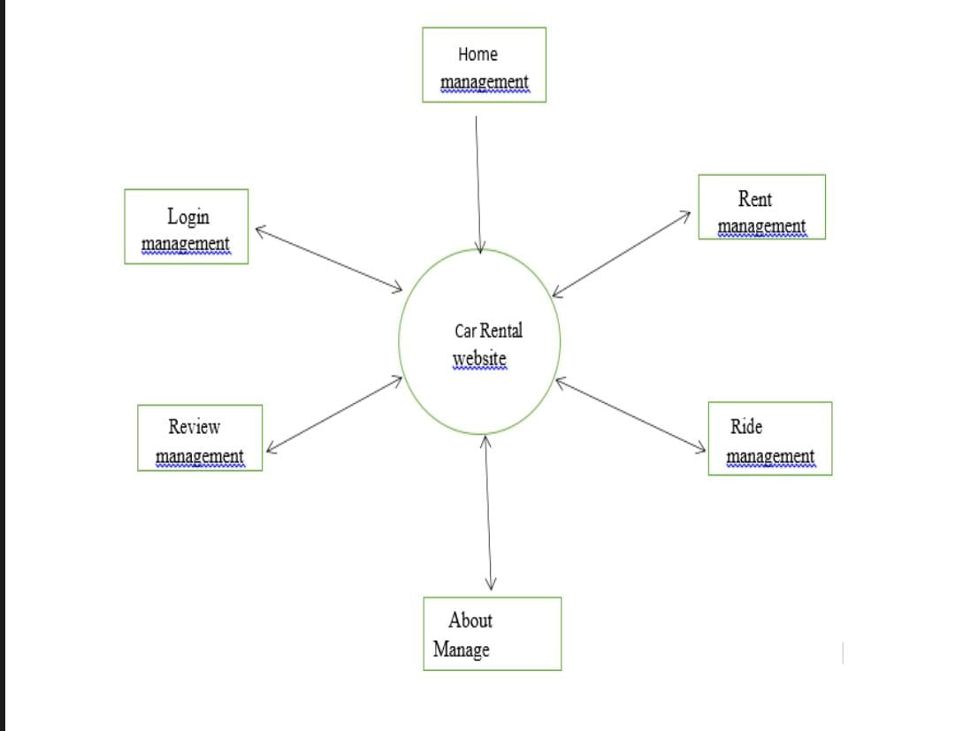
Zero level Dfd

Slide 6
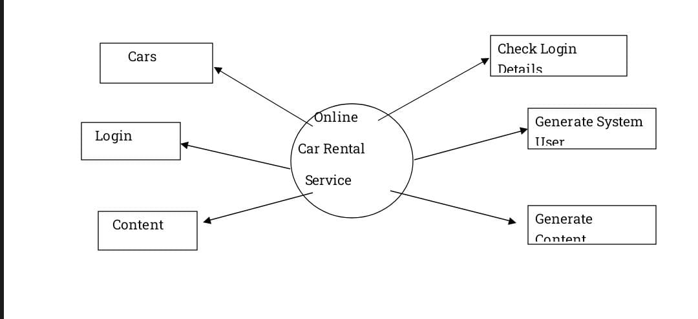
Dfd 1 diagram

Slide 7
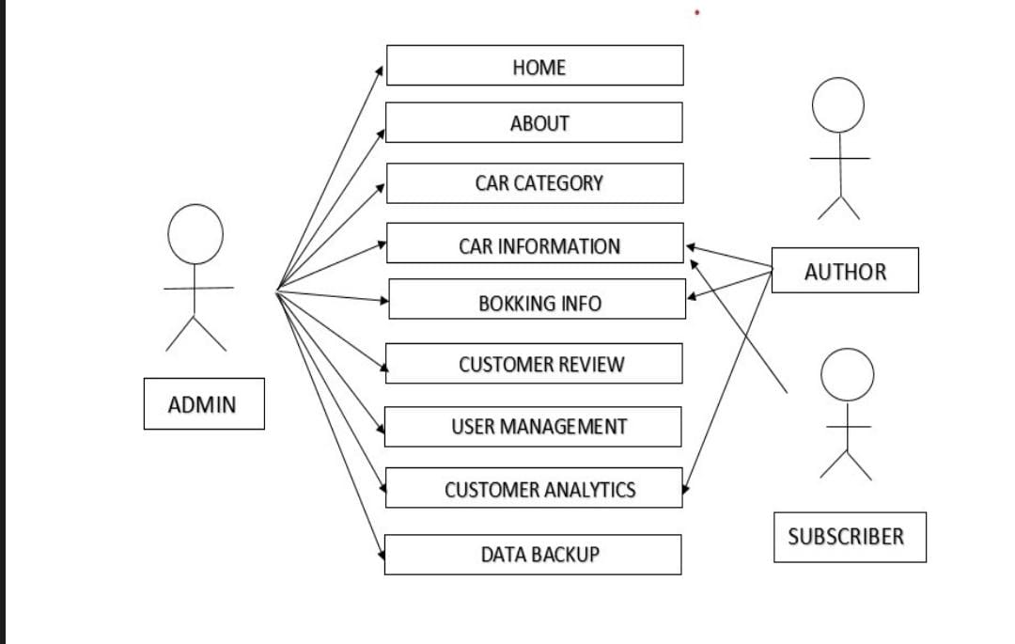
Use case diagram

Slide 8
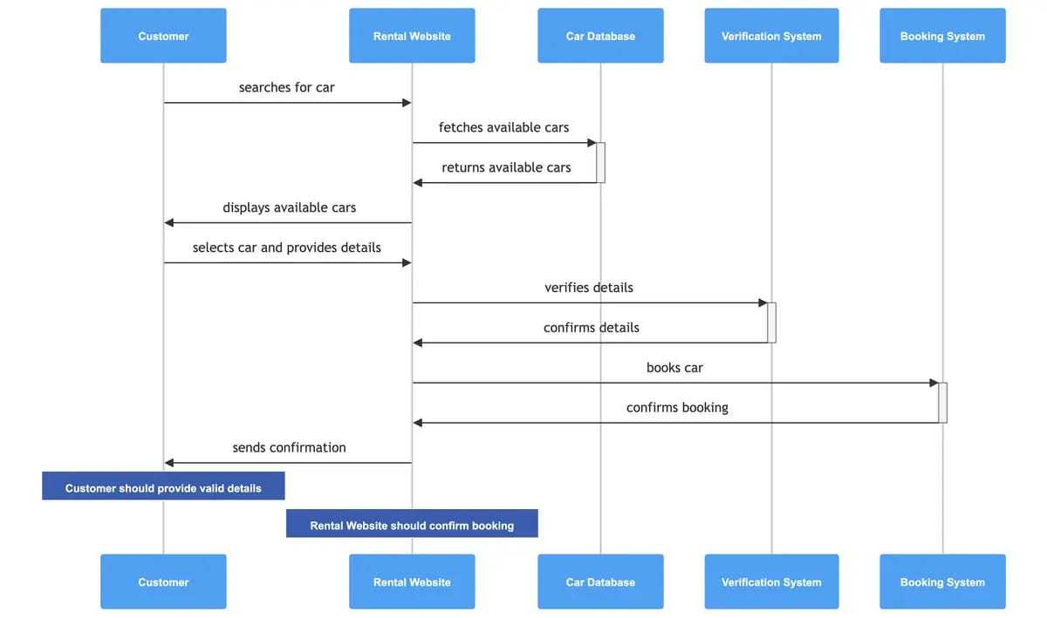
Sequence diagram

Slide 9
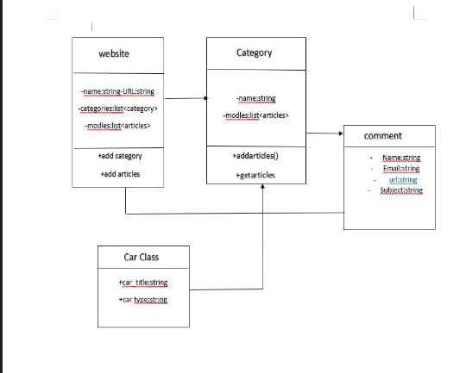
CLASS DIAGRAM

Slide 10
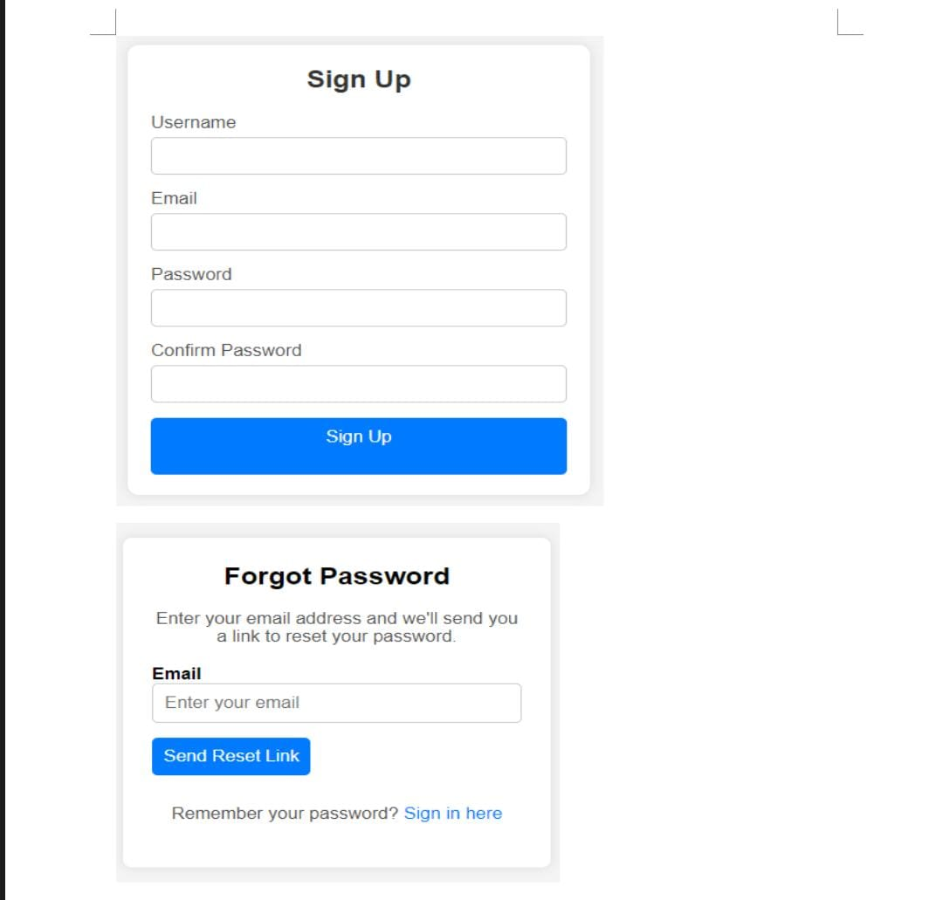
Input screen

Slide 11
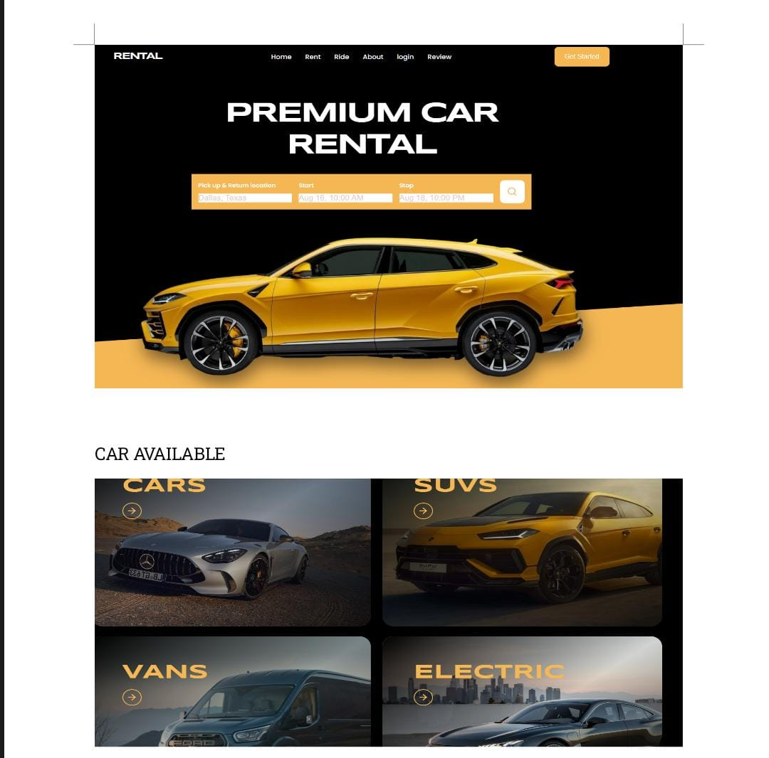
Output screen

Slide 12
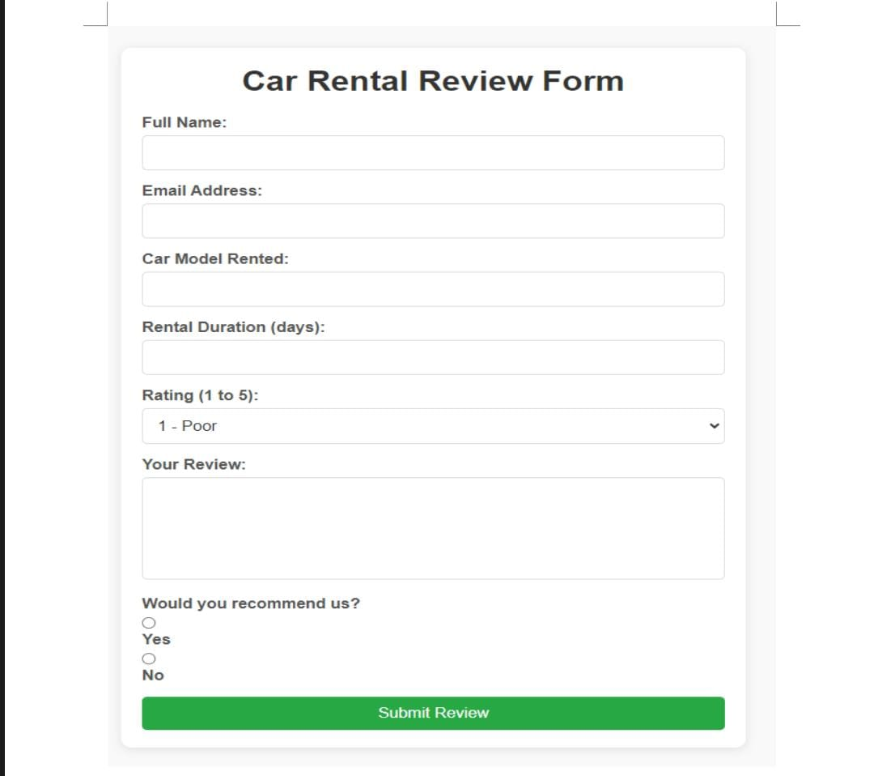
Review form

Slide 13
CONCLUSION
n conclusion, [Your Company Name] aims to transform the car rental experience by offering a seamless, reliable, and customer-friendly platform. With a focus on ease of use, flexible rental options, a wide variety of vehicles, and secure transactions, we ensure that customers have a hassle-free and enjoyable experience from booking to return. As we continue to innovate and adapt to changing customer needs, [Your Company Name] is committed to setting new standards in the car rental industry, making mobility more accessible and convenient for all.

Slide 14
THANK YOU

